Slide 1
Using AI to solve performance problems
Salesforce Performance Engineering
Jasmin Nakic | Jackie Chu
June, 2018

Slide 2


Salesforce
Performance Engineering
Jasmin Nakic
Jackie Chu
Lead Performance Engineer
Lead Performance Engineer

Slide 3
Forward-Looking Statements
Statement under the Private Securities Litigation Reform Act of 1995:
This presentation may contain forward-looking statements that involve risks, uncertainties, and assumptions. If any such uncertainties materialize or if any of the assumptions proves incorrect, the results of salesforce.com, inc. could differ materially from the results expressed or implied by the forward-looking statements we make. All statements other than statements of historical fact could be deemed forward-looking, including any projections of product or service availability, subscriber growth, earnings, revenues, or other financial items and any statements regarding strategies or plans of management for future operations, statements of belief, any statements concerning new, planned, or upgraded services or technology developments and customer contracts or use of our services.
The risks and uncertainties referred to above include – but are not limited to – risks associated with developing and delivering new functionality for our service, new products and services, our new business model, our past operating losses, possible fluctuations in our operating results and rate of growth, interruptions or delays in our Web hosting, breach of our security measures, the outcome of any litigation, risks associated with completed and any possible mergers and acquisitions, the immature market in which we operate, our relatively limited operating history, our ability to expand, retain, and motivate our employees and manage our growth, new releases of our service and successful customer deployment, our limited history reselling non-salesforce.com products, and utilization and selling to larger enterprise customers. Further information on potential factors that could affect the financial results of salesforce.com, inc. is included in our annual report on Form 10-K for the most recent fiscal year and in our quarterly report on Form 10-Q for the most recent fiscal quarter. These documents and others containing important disclosures are available on the SEC Filings section of the Investor Information section of our Web site.
Any unreleased services or features referenced in this or other presentations, press releases or public statements are not currently available and may not be delivered on time or at all. Customers who purchase our services should make the purchase decisions based upon features that are currently available. Salesforce.com, inc. assumes no obligation and does not intend to update these forward-looking statements.

Slide 4
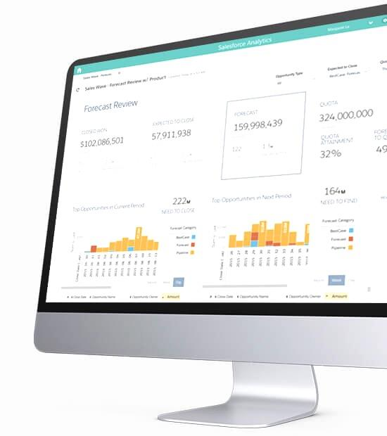
Agenda
Presentation and Tutorial
Welcome | Audience: Sysadmins, performance engineers and developers Level: Beginner
Introduction | Introduction to Predictive Performance Analytics Machine Learning Use Case - Classification Machine Learning Use Case - Trending Prediction
Hands-on | Prepare Input Data Build and Compare Predictive Models Generate Test Result Classification Generate Dynamic Alerts
Summary | Q&A

Slide 5
Setup
Please follow instructions:
https://github.com/sfperfdemo/vel2018-ai

Slide 6
Machine Learning Use Case
Performance Test Result Classification

Slide 7
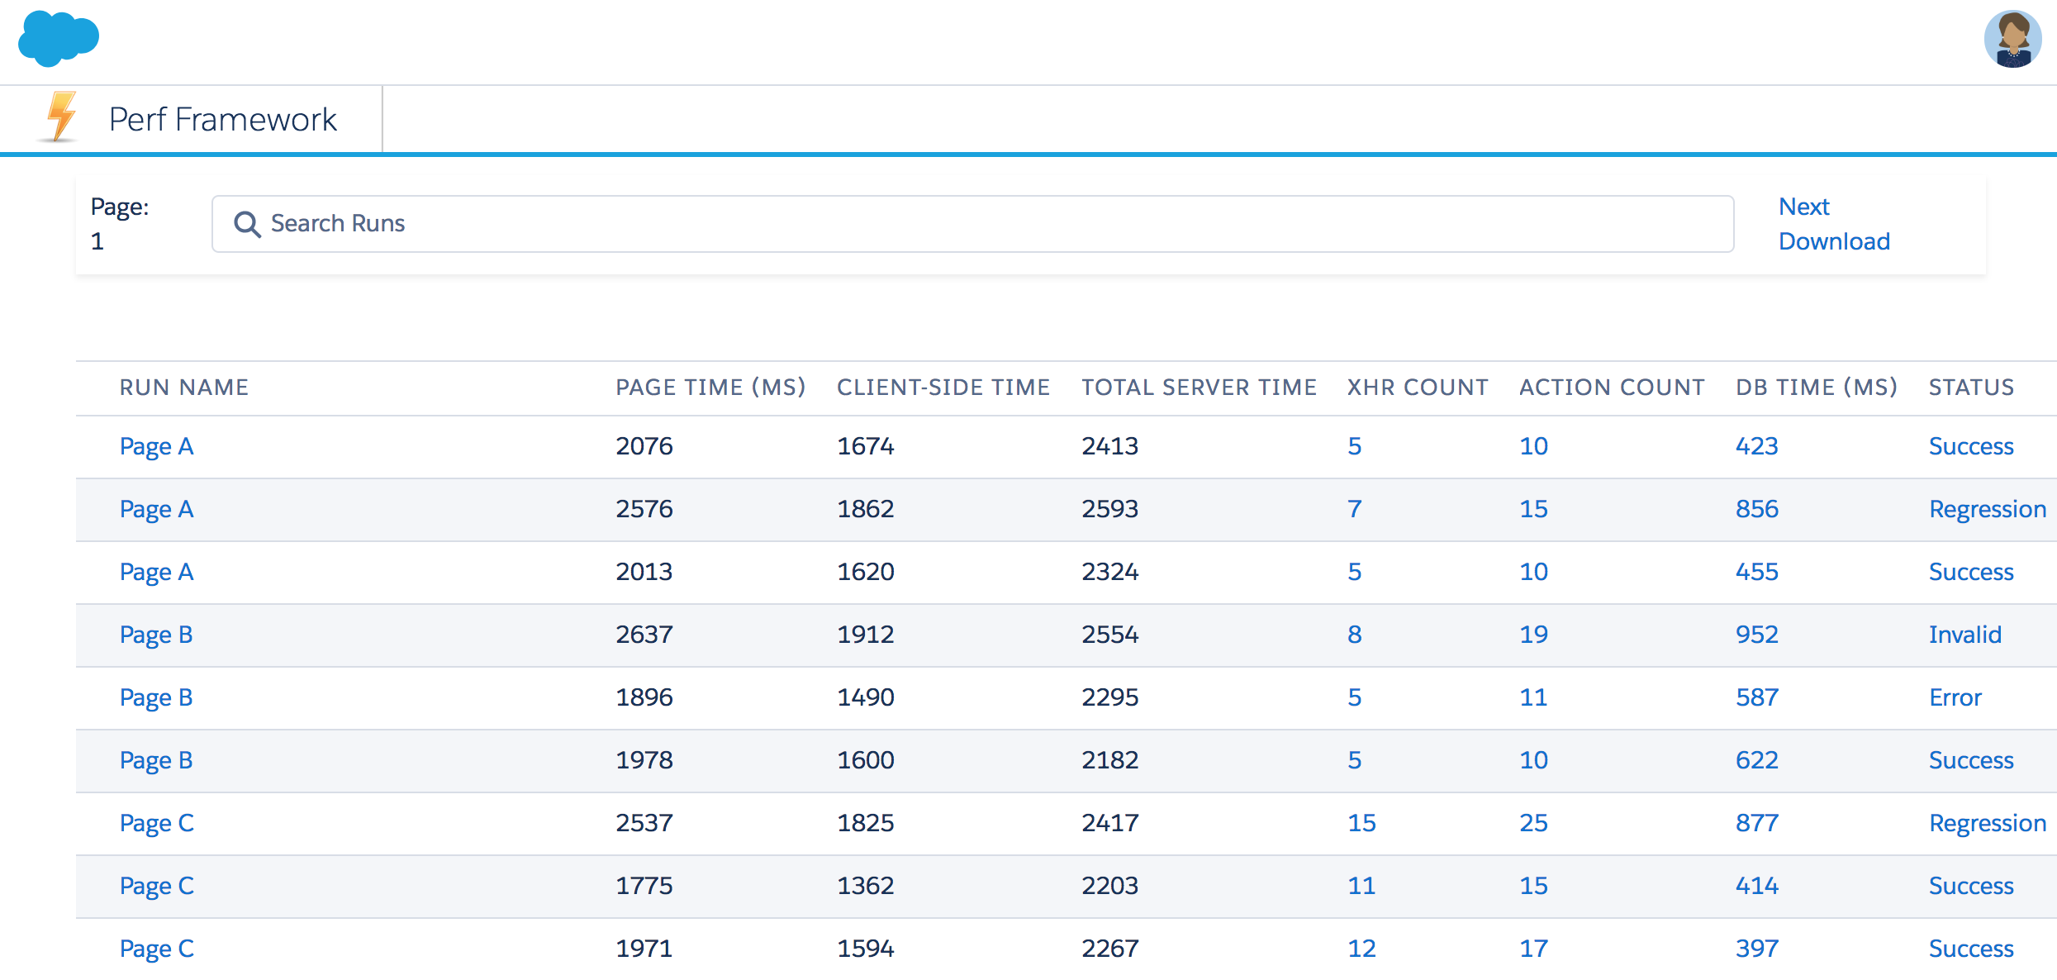
Use Case: Perf. Test Result Classification
Hundreds of performance tests executed each day

Slide 8
Use Case: Perf. Test Result Classification
Many potential causes for variances
Performance bugs in code
Testing framework problems
Testing Hardware issues
Data problems
New features introduced and causing changes
...many more

Slide 9
Use Case: Perf. Test Result Classification
Classification -> Time-consuming work
Manually validating test result take > 2 minutes
~30% tests do not succeed
Minimum 10 - 15 minutes to identify the issue
To manually validate all tests executed -> 10 hours each day
More features == more test executions
Amount of work is constantly increasing!
Becoming exponentially difficult over time

Slide 10
Use Case: Perf. Test Result Classification
Sample Key Metrics (Performance for a web page)
Total Page Time
Browser Processing Time
Server Processing Time (for each request)
Chrome Timelines
Action Time (for each action in server request)
# of database operations
Database process time
# of api calls
API process time
… many more

Slide 11
Use Case: Perf. Test Result Classification
How can Machine Learning help?
Classify test-runs based on relevant features
Help quickly identify potentially issues
Provide insights on test-runs
E.g. “<XHR/API name> had a significant improvement/regression.”
E.g. “Database time is too high. There is potential hardware issue”
E.g. “Client side processing time is unstable. Potential Test device issue”

Slide 12
Use Case: Perf. Test Result Classification
Benefits
Reduce time spent on manual process & allows engineers to focus on larger scale projects
Automatically adapt and handle changes
Quickly identifies potential cause of variance / issue

Slide 13
Hands-on Exercise
Decision Tree Classifier

Slide 14
Use Case: Perf. Test Result Classification
Training Dataset
examples used for learning
fit the parameters
Testing Dataset
independent of the training dataset
follows the same probability distribution as the training dataset
For this exercise: PerfRun_TrainingData.csv
For this exercise: PerfRun_TestData.csv

Slide 15
Use Case: Perf. Test Result Classification
Features (Simplified example for this exercise)
PageTime_ms,
TotalServerTime_ms,
TotalBrowserTime_ms,
Action_count,
Api_count,
Db_count,
DbTime_ms,
Xhr_count

Slide 16
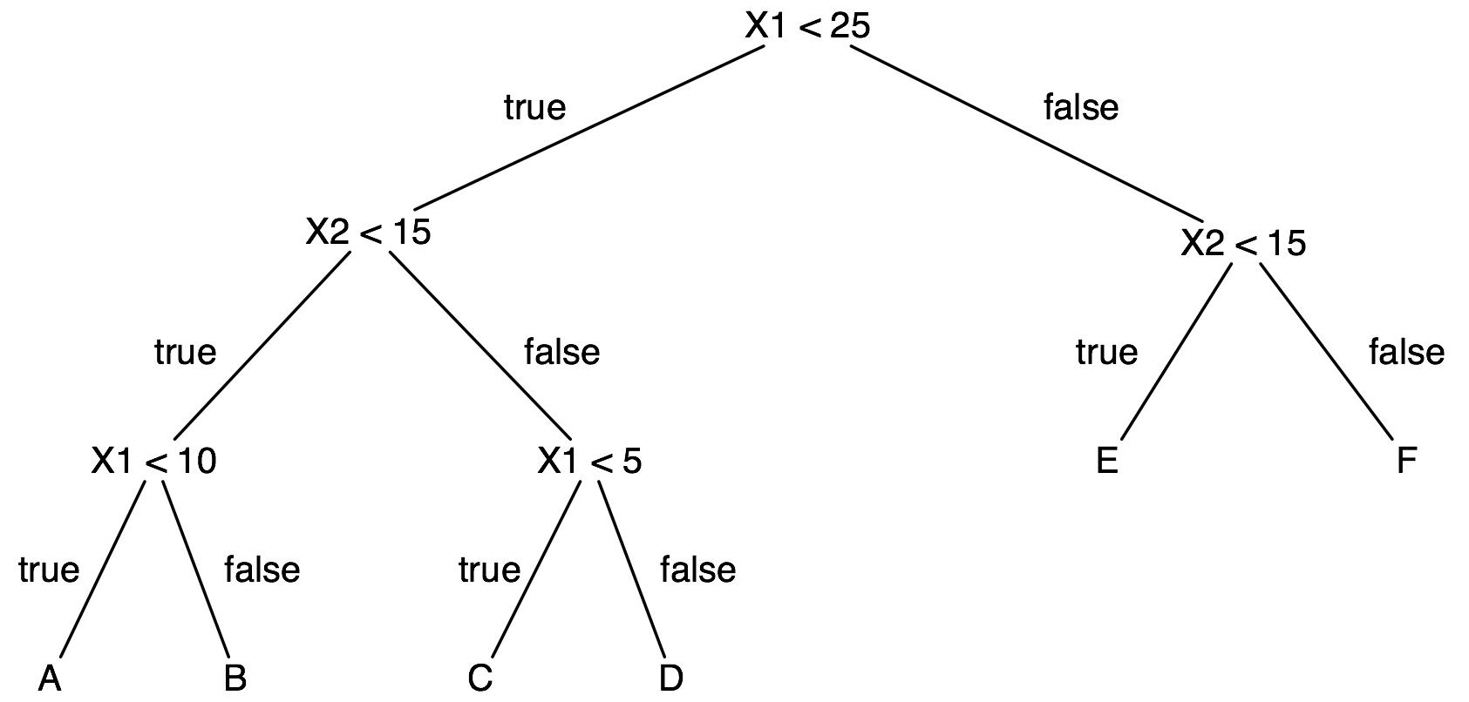
Use Case: Perf. Test Result Classification
Basic Classifiers
Exercise #1 - Decision Tree
Choose variable at each level that best splits the dataset splits the data

Slide 17
Hands-on Exercise
Decision Tree Classifier Model Fit

Slide 18
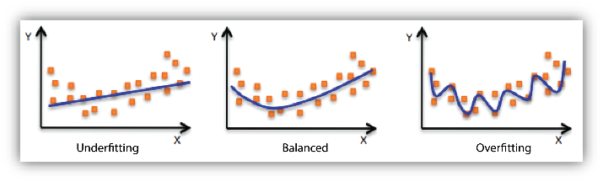
Use Case: Perf. Test Result Classification
Overfitting
model is too flexible - performs well on the training data, but not on the testing data
Underfitting
model is too simple - performs poorly on the training data

Slide 19
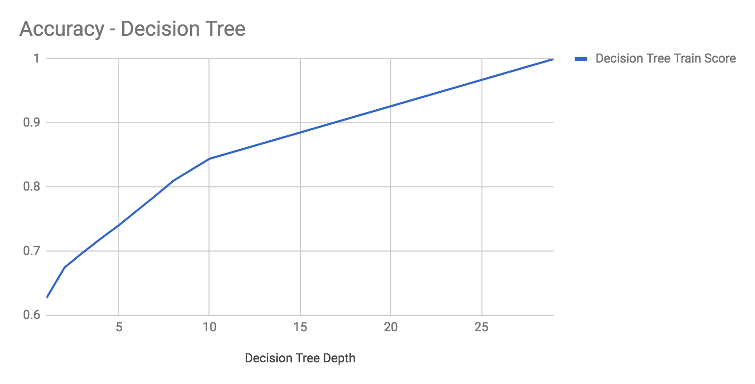

Use Case: Perf. Test Result Classification
Decision Tree Classifier
Tree Depth
Model Flexibility
Training Score

Slide 20
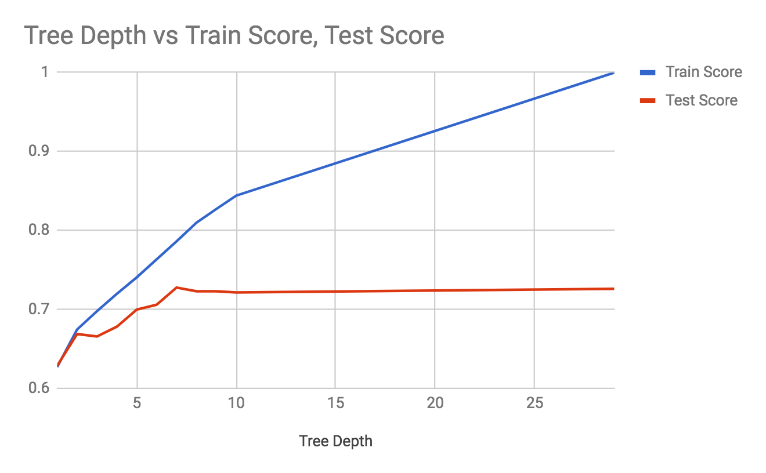
Use Case: Perf. Test Result Classification
Decision Tree Classifier
Overfitting & underfitting?

Slide 21
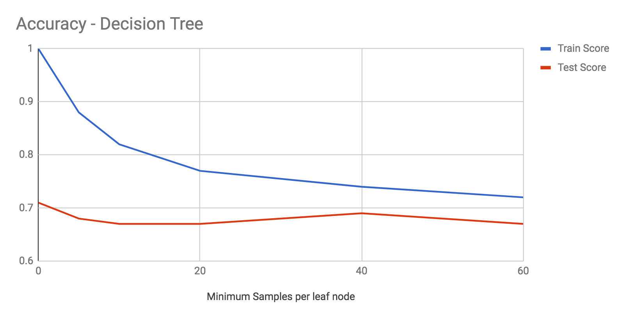
Use Case: Perf. Test Result Classification
Decision Tree Classifier
Min Sample / Leaf
Model Flexibility
Training Score

Slide 22
Hands-on Exercise
Random Forest Classifier

Slide 23
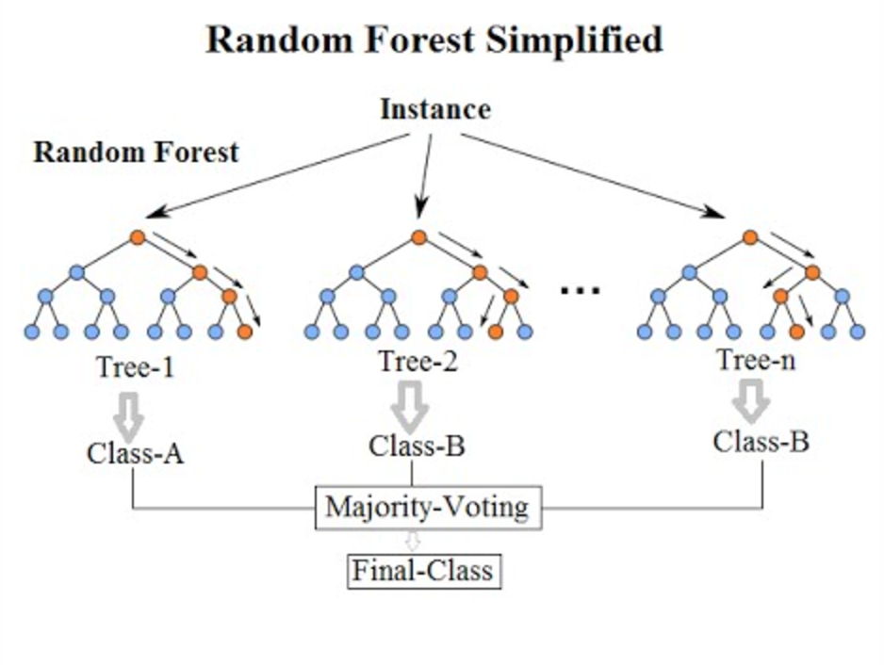
Use Case: Perf. Test Result Classification
Basic Classifiers
Exercise #2 - Random Forest
ensemble learning - constructing a multitude of decision trees at training time
Avoid overfitting to training set

Slide 24
Machine Learning Use Case
Trending Prediction

Slide 25





Challenges in Performance Analytics
Predict
Alert
Understand
Make predictions using machine learning
Detect anomalies and exceptions on current system performance data
Generate alerts based on dynamic thresholds
Estimate impact of difference between predicted and real values
Visualize
Understand short and long term trends
Find periodic pattern in performance metrics
Visualize predictions vs. actual metrics
Deliver data to other teams and executives
Notes:
Briefly cover the each item or split into two slides

Slide 26
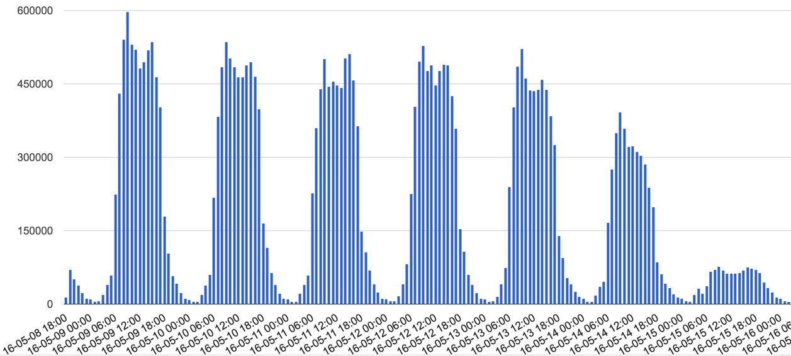
Use Case: Predicting Performance and Detecting Anomalies
Data show daily and weekly periodic patterns
Long running trend with gradual increase
Exceptions from typical daily metric shape

Slide 27
Selecting the Feature Set
Features can be generated or collected from external systems
Timestamp Formats
Timestamp Components
Binary Features
Timestamp as a string:
2016-05-08 19:00:00
Ordinal date as decimal date plus time:
736092.791667
Year, Month, Day
Hours, Minutes, Seconds
DayInWeek, WeekInYear
Quarter
isMonday, isTuesday, …, isSunday
isHour0, isHour1, isHour2, ..., isHour23
H_d_{i}_h_{j} where d_{i} is for weekday in range 0..6 and h_{j} is for hour in range 0..23
isHoliday
Use ordinal time for long term trends
Commonly used in Analytics
Binary features have values 0 or 1
A feature is an individual measurable property of a phenomenon being observed. (Wikipedia)

Slide 28
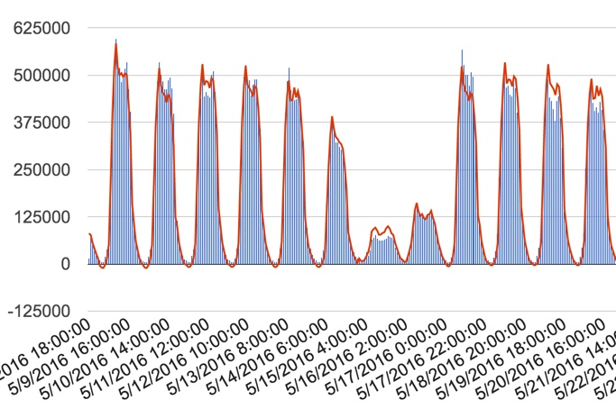
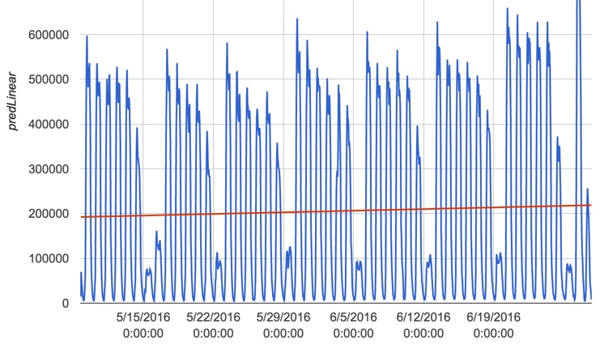
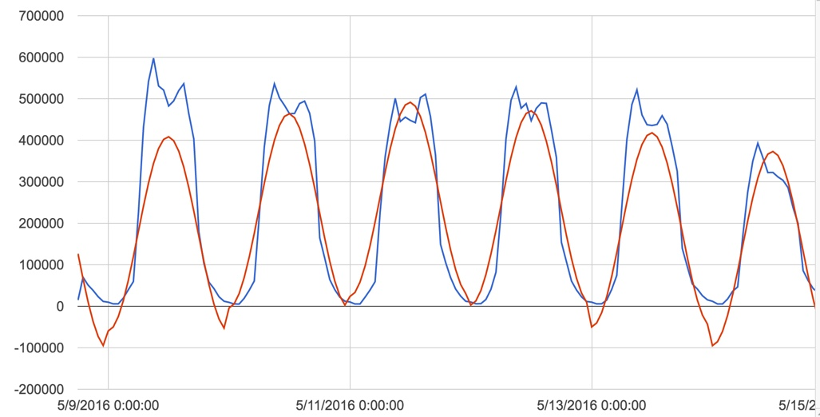
Linear Regression Models
Examples of linear regression models that apply to performance data
Simple linear regression model:
y = c₀ + c₁*x
Model with periodic trigonometric features:
y = c₀ + c₁*x + c₂*sin(x*2*pi/f + t)
Where t is time offset and f is frequency
Model with binary features:
y = c₀ + c₁*x₁ + c₂*x₂ + … c_{n}*x_{n}
Where x_{n} can be 0 or 1
Linear regression helps you find coefficient values (c₀, c₁, ... c_{n})

Slide 29
Machine Learning Development Process
From raw data to predictions
TrainingData
Select Feature Set
Build the Model
Validate the Model
Measure the model score until it stops improving
Iterative Process
Is Model OK?
Convert input data to a format accepted by ML tools
No
Yes
Model
Load
Test Data
Extract Feature Set
Apply the Model
Predictions

Slide 30
How Good is the Model?
Generate the “score” for each model to see how well it fits input data
Model | Training Score | Test Score | Comments
Simple Linear | 0.0014 | -0.0052 | Not useful
Trigonometric | 0.7284 | 0.7148 | Periodic, but functions are complicated
Prediction Hour/Day | 0.8280 | 0.8048 | Each day has the same pattern
Prediction Hour/Week | 0.9240 | 0.8918 | Does not make good prediction on holidays
Prediction incl. Holidays | 0.9520 | 0.9444 | Does not make good prediction on Sundays
Prediction incl. Sundays | 0.9522 | 0.9504 | Optimal
Models with more relevant features tend to have higher score
Test data score is the measure of model quality

Slide 31
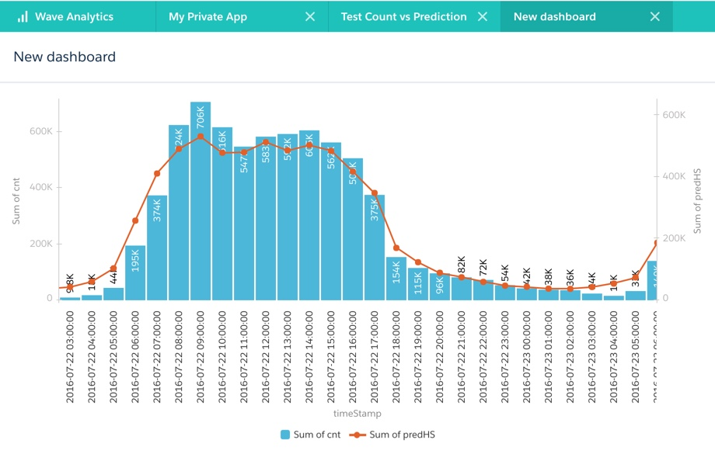
Visualization using Salesforce Analytics
Effective visualization of predictive data
Compare actual metrics to prediction
Display alerts for detected anomalies
Correlate performance metrics with business data
Build the dashboard to share with other teams and executives

Slide 32
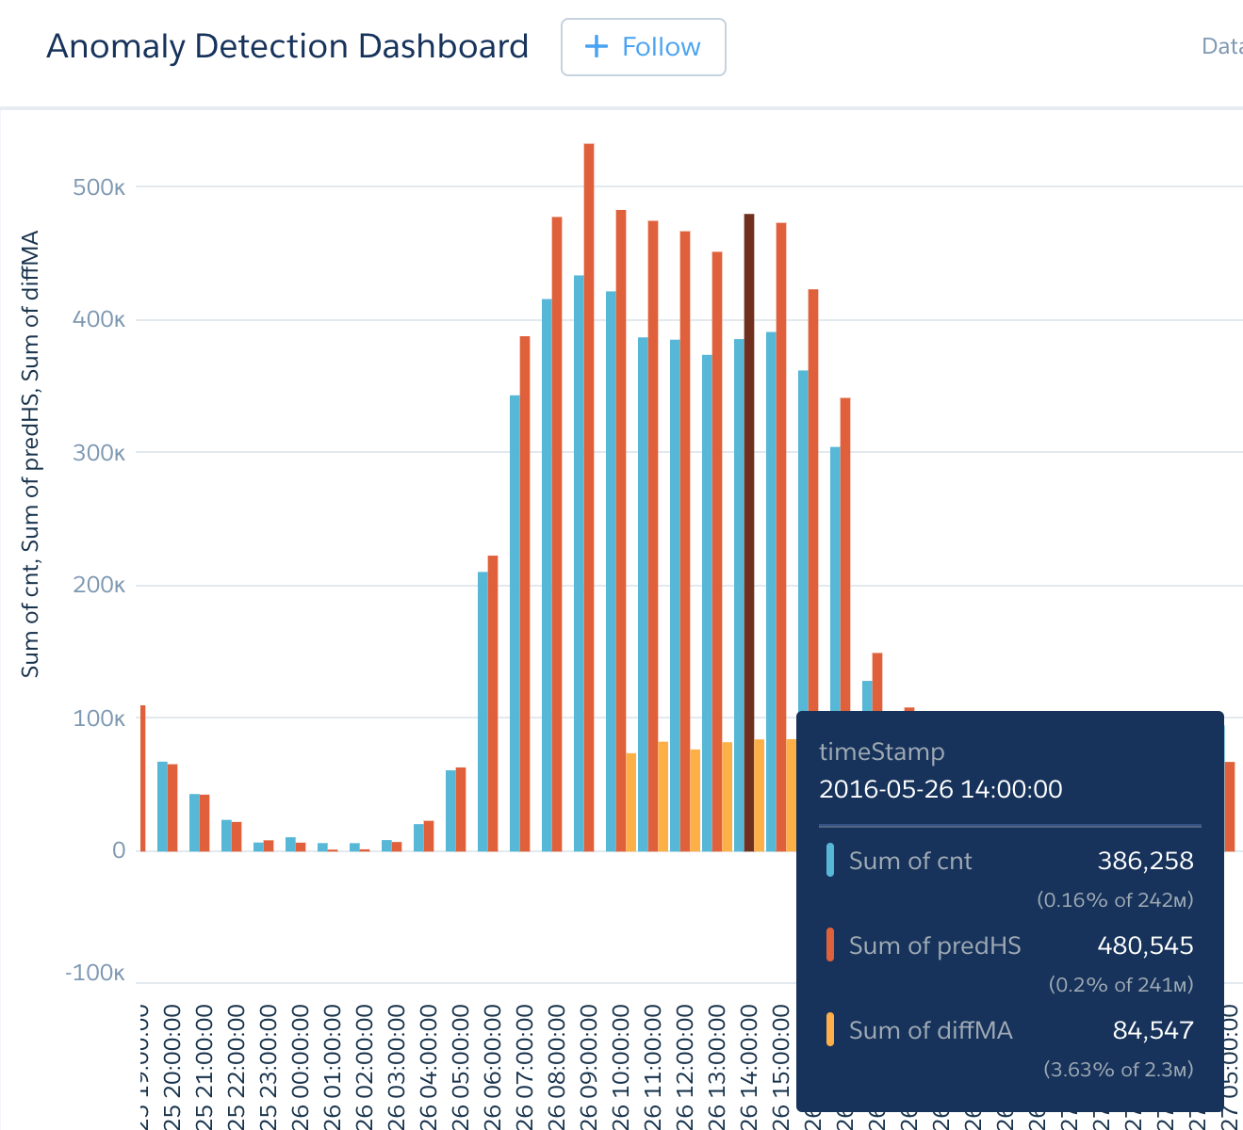
Dynamic Alerts
Anomaly detection for near real time notification
Typically alerts are based on static threshold values, for example higher than 85%.
If the value is higher (or lower) then prediction based threshold, generate the alert
We want to separate data noise from anomalies using prediction interval
Cover false positives and false negatives if possible
Define the impact, for example: if a metric is for three hours more than X in absolute value and more than Y in percentage

Slide 33
Anomaly Detection
Using predictive models
Define “moving window”
Horizontal size – number of measures (for example: last 3 hours)
Vertical size – Allowed difference between the actual value and the prediction
Anomaly Impact
High value – The metric value is higher than the prediction
Low value – The metric value is lower than the prediction
Impact Thresholds – define if the anomaly needs immediate action
“Alert” – send notification and require immediate attention from operations
“Warning” – create a follow up action for technical or business experts

Slide 34
Implementation Summary
What did we cover today?
Develop predictive system applying machine learning methods
Analyze input data and predictions to solve business needs
Prepare the training data set,
Build the predictive model,
Predict the metric value for the test data set
Measure the quality of the predictive model
Find short and long term performance trends
Detect Anomalies in near real time
Implement a simple alert system
Visualize data using Salesforce Wave

Slide 35



Next Steps and Resources
Get Demo Scripts from GitHub
https://github.com/sfperfdemo/vel2018-ai
Get Salesforce Wave Utilities
https://github.com/forcedotcom/Analytics-Cloud-Dataset-Utils
Visit Salesforce Wave Tutorial
http://www.salesforce.com/analytics-cloud/overview/
Explore Machine Learning in Python (scikit)
http://scikit-learn.org

Slide 36
Q & A
Questions and Answers

Slide 37


